Slide 1
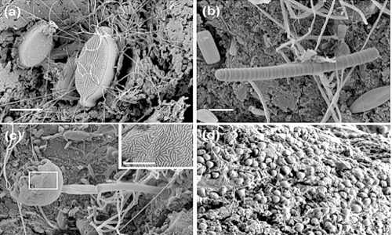
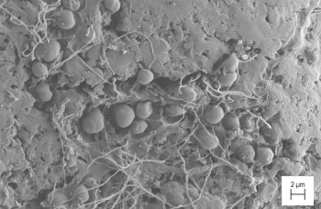
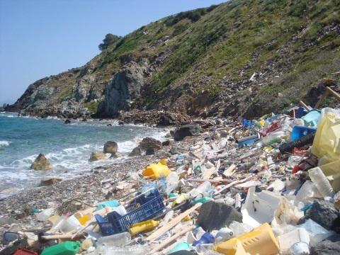
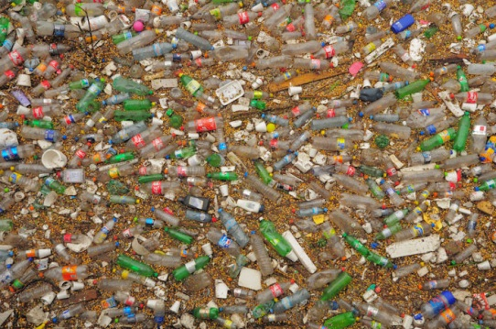
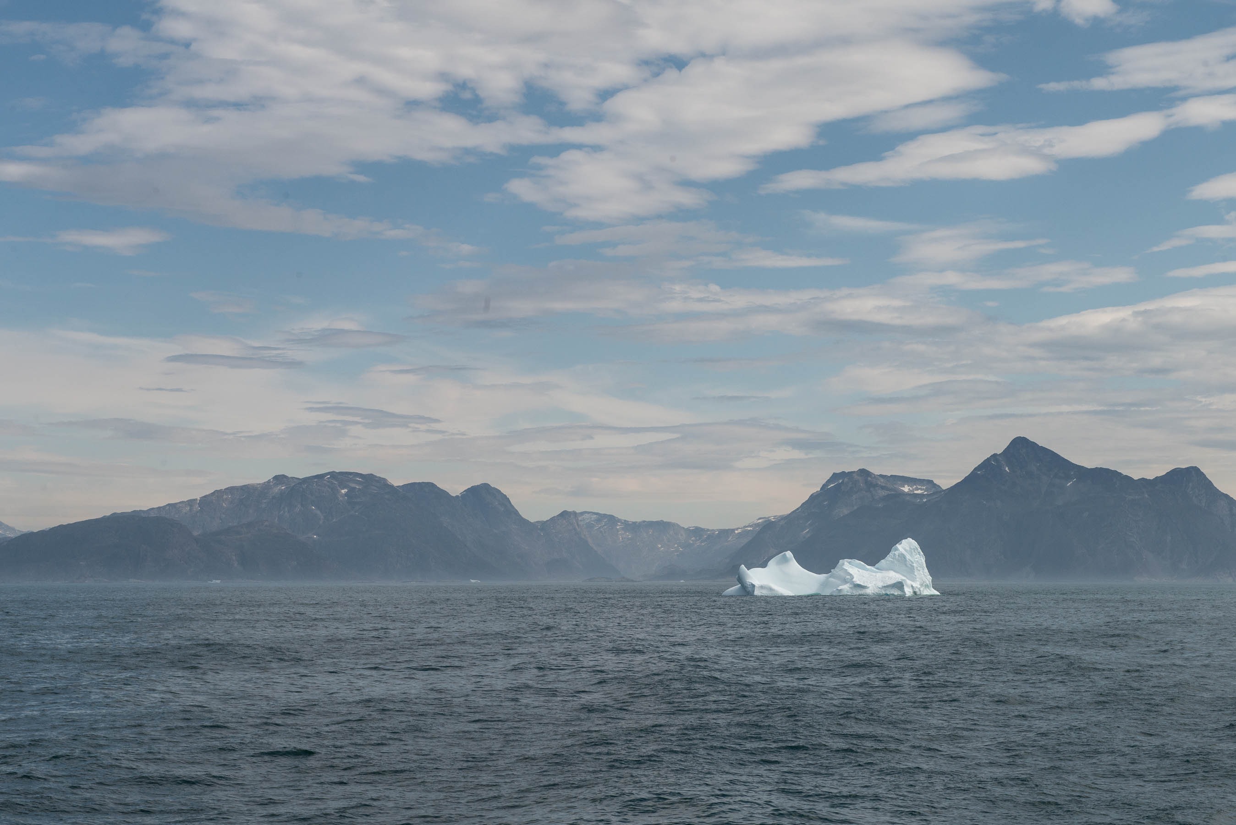
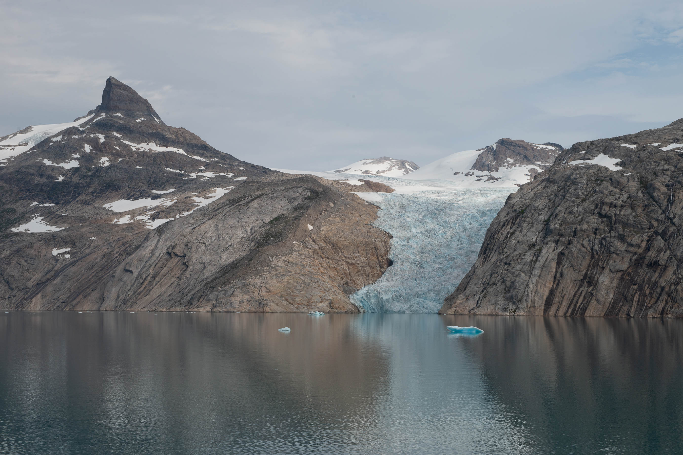
Microbial Oceanography Working Group
Dept. of Functional and Evolutionary Ecology
(microbial-oceanography.eu)
Topics available:
1) Marine fungi: abundance and activity
2) Microbial community composition in Artic waters subjected to global change
Background required in:
Marine Science, microbial ecology and chemistry
Contact for further information: Gerhard J. Herndl, Federico Baltar
Email: gerhard.herndl@univie.ac.at, Federico.Baltar@univie.ac.at
Further information on ongoing projects:
www.microbial-oceanography.eu
Notes:
This is another option for an overview using transitions to advance through several slides.

